Slide 1
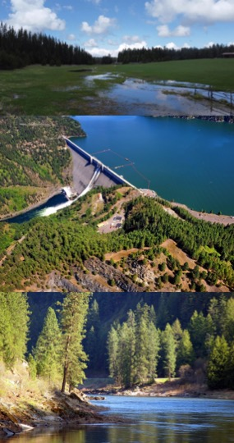






Overview of Water Quality Models and Libraries
Water Quality and Contaminant Modeling Branch
Environmental Laboratory
Engineer Research and Development Center (ERDC)
U.S. Army Corps of Engineers (USACE)
February 29, 2024

Slide 2
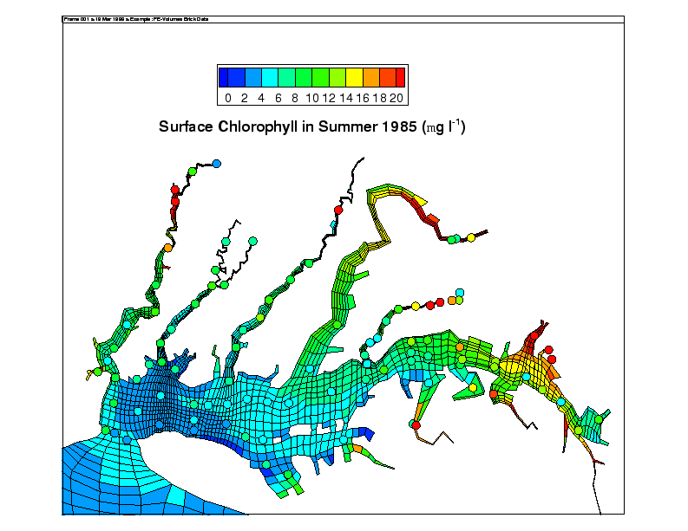
CE-QUAL-ICM
Fully 3D, time-variable; link to hydrodynamics
Developed through Chesapeake Bay study, now generalized, public domain, applied to many other sites
Full suite of nutrients and trophic interactions
Includes SAV, benthos, zooplankton, sediment diagenesis
Conventional pollutants and contaminants (ICM/TOXI)

Slide 3
Carbon and Phosphorus Cycles

Slide 4
Nitrogen & DO Cycles

Slide 5
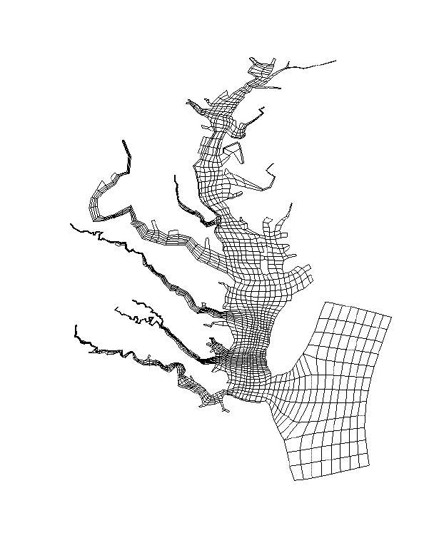
ERDC CE-QUAL-ICM Applications
Chesapeake Bay (numerous)
Inland Bays of Delaware
New York Bight
Newark Bay
New York - New Jersey Harbors and Estuaries
San Juan Bay, Puerto Rico
Los Angeles - Long Beach Harbors (multiple)
Aberdeen Proving Grounds
Florida Bay
Grand Calumet River
Lake Washington
Lower Green Bay
Hilo Bay, HI
Cache River Wetland
Mississippi Sound, MS
Mobile Bay Channel Deepening
Dauphin Island NFWF

Slide 6
ICM Hydro Requirements
Volume Conservative Flow Field
Time Invariant Data
Cell Lengths
Flow Face Areas
Cell Surface Areas
Initial Cell Volume
Time Varying Data
Horizontal flows
Vertical flows
Cell volumes to verify conservation

Slide 7
COREQUAL
Water-Quality Kinetics Host-Integrated Library
Purpose: Provide capabilities of performing simulations of water quality processes and constituents within host hydrodynamic models.
Time: 2021-2022
Water Quality algorithm sources:
ICM – kinetics algorithms. Latest version (2020) obtained from Cerco.
ICM-LITE – For identification of minimum viable set of constituent pools
Initial conceptual prototype delivered to CHL personnel summer 2022.
Prototype was to serve as testbed for developing code, computation and linkage of WQ-kinetics subroutines and subsequent transport of WQ constituent pools.

Slide 8

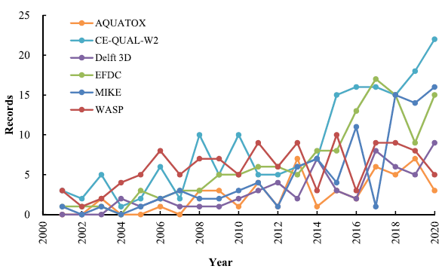
CE-QUAL-W2 Overview
CE‐QUAL‐W2 is a two‐dimensional (2D), longitudinal/vertical, hydrodynamics and water quality model that enables characterization of vertical and longitudinal changes in reservoirs.
The model assumes reservoirs are well mixed laterally, with no variation from one channel side to the other in a layer (vertical) and segment (longitudinal).
CE-QUAL-W2 has been applied to rivers, lakes, reservoirs, and estuaries.
Ecological Modelling 466 (2022) 109888

Slide 9

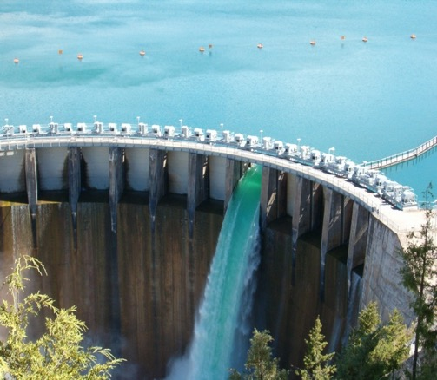
CE-QUAL-W2 Capabilities
Longitudinal-vertical hydrodynamics and water quality in stratified and non-stratified systems
Nutrients-dissolved oxygen-organic matter interactions
Fish habitat
Selective withdrawal from stratified reservoir outlets
Hypolimnetic aeration
Multiple algae, epiphyton/periphyton, zooplankton, and macrophytes
CBOD
Sediment diagenesis model
Generic water quality groups
Internal dynamic pipe/culvert model
Hydraulic structures (weirs, spillways) algorithms, including a dynamic shading algorithm based on topographic and vegetative cover.

Slide 10
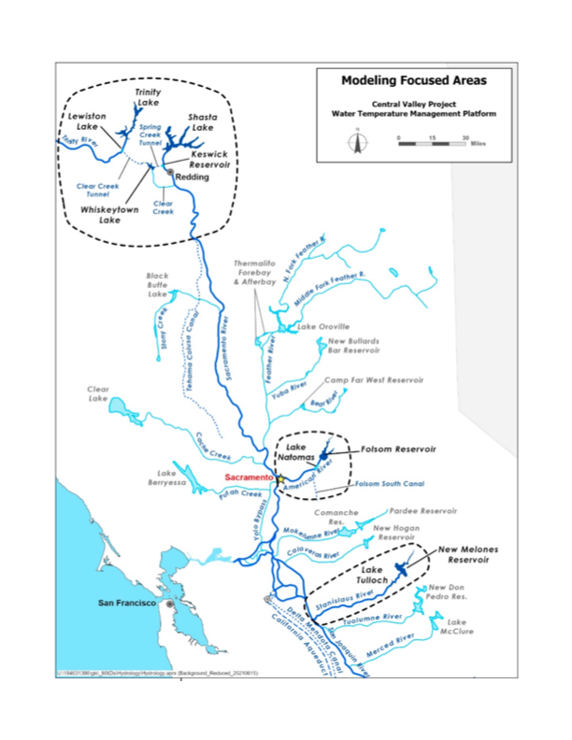
Past and Current Applications of CE-QUAL-W2
CE-QUAL-W2 is widely used by USACE and other federal, state, and local agencies for environmental impact assessments, planning studies, etc. Agencies that use CE-QUAL-W2 as their standard reservoir water quality model include:
U.S. Geological Survey (USGS)
U.S. Bureau of Reclamation
U.S. Environmental Protection Agency (EPA)
State of California
More than 1,100 model applications have been developed worldwide for reservoirs, rivers, estuaries, and other water bodies since CE-QUAL-W2 was released in 1986.
CE-QUAL-W2 is also used as a research tool by researchers at universities and other organizations.
At least 1,500 publications utilized or cited CE-QUAL-W2 in the year 2022 alone.
Recent Studies:
Water Temperature Modeling Platform, California Central Valley Project (USBR and State of California): This platform applies CE-QUAL-W2 for ongoing and future operations decision-making
USACE Northwest Division, Columbia and Snake River Watershed
Columbia System Reservoir Operation (CRSO) Project
Columbia River Treaty (CRT) Project
Philadelphia District, Lehigh River Water Quality Modeling
Region of Application:
Water Temperature Modeling Platform
California Central Valley Project

Slide 11
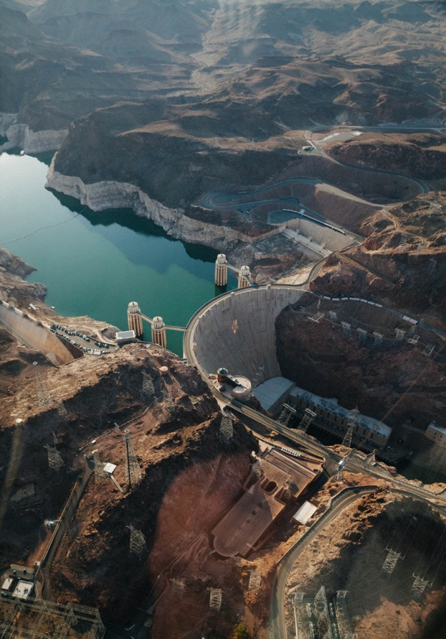
CE-QUAL-W2 Model Benefits
Since 1986, CE-QUAL-W2 has been used by water quality managers to assess impacts of management strategies on reservoir, lake, and estuarine systems.
CE-QUAL-W2 computes the two-dimensional velocity field for narrow systems that stratify.
In contrast with reservoir models with simplified hydrodynamics, CE-QUAL-W2 accurately simulates vertical and longitudinal transport of constituents, which can be as important as chemical kinetics in accurately simulating water quality.
Applications of CE-QUAL-W2 include
Planning Studies
Environmental Impact Assessments
Ecosystem Restoration Projects
Real-Time Systems Operation and Decision-Making

Slide 12
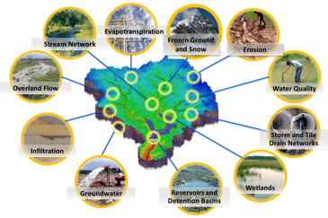
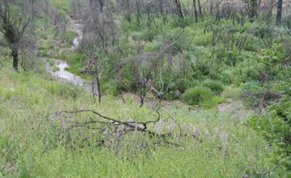
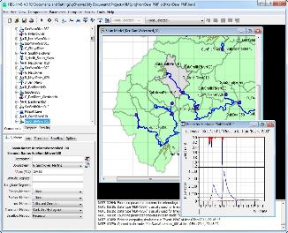
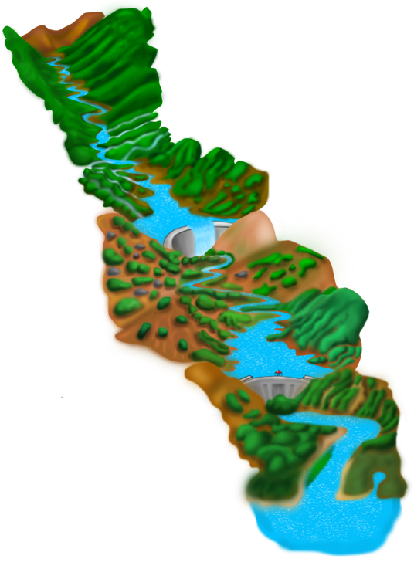
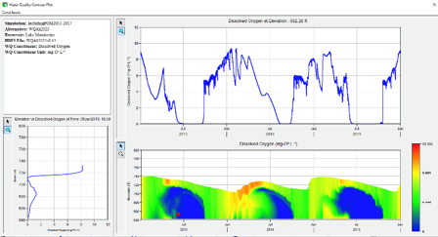
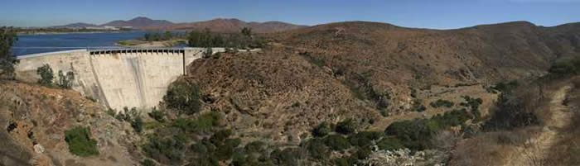
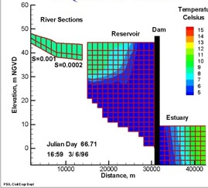
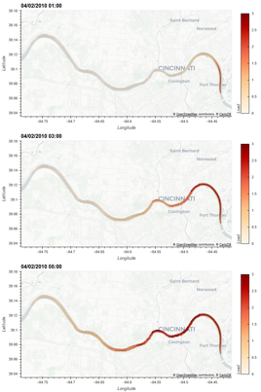
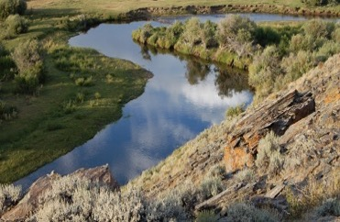
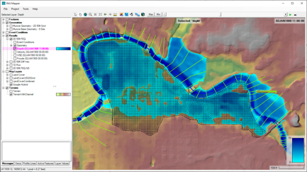
Water Quality and Environmental Systems Modeling
Temperature
Nutrients
Dissolved Oxygen
Algae
Metals
Contaminants
ERDC’s Corps Library for Environmental Analysis and Restoration of Watersheds (ClearWater) provides environmental simulation capabilities that leverage existing hydrologic and hydraulic (H&H) models.
Water quality modeling tools:
Watershed Runoff:
GSSHA: Surface and sub-surface water quality modeling
HEC-HMS: Surface runoff temperature modeling
Reservoirs:
CE-QUAL-W2: 2D reservoir-river hydrodynamics and water quality modeling
HEC-ResSim: Reservoir operations and water quality modeling
Rivers and Floodplains:
HEC-RAS: 1D River hydraulics and water quality & vegetation modeling
ClearWater-Riverine: 2D River-floodplain hydraulics and water quality modeling with HEC-RAS-2D
Estuary
Key: ERDC-EL – ERDC-CHL – HEC

Slide 13
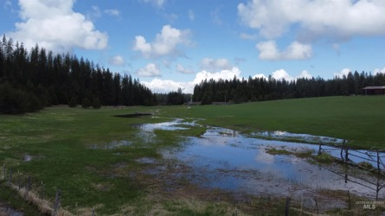
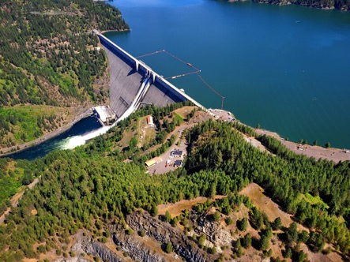
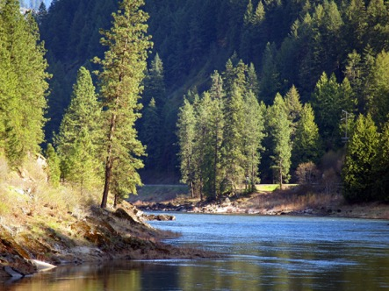
ClearWater: Next Generation Integrated Water Quality Modeling
ClearWater: Corps Library for Environmental Analysis and Restoration of Watersheds
Purpose: Link environmental models with existing water resources models that simulate runoff, rivers, and reservoir hydraulics and hydrology
ClearWater provides environmental simulation capabilities that are designed to leverage existing water resources models.
The ClearWater water quality modules simulate constituent kinetics, heat budget processes, and vegetation growth cycles. Capabilities include:
NSM: Nitrogen, phosphorus, and carbon cycling; dissolved oxygen, algae, etc.
TSM: Temperature (heat budget)
GSM: General Constituents
CSM: Organic and inorganic contaminants
MSM: Mercury
ClearWater contains legacy modules written in Fortran and C++ and next-generation modules written in Python (NSM and TSM)
Engine computes the transport (advection and diffusion) of heat and constituent mass across the watershed
Data visualization capabilities
Framework to integrate multiple models.
Open Source
Runoff
Reservoirs
Rivers

Slide 14



Integrated Environmental Modeling
Objective: an integrated ecohydrology modeling system that simulates heat and nutrient flow through ecosystems.
Water Resources Models
Water Quality Models (Nutrients & Temperature)
Ecological Models

Slide 15
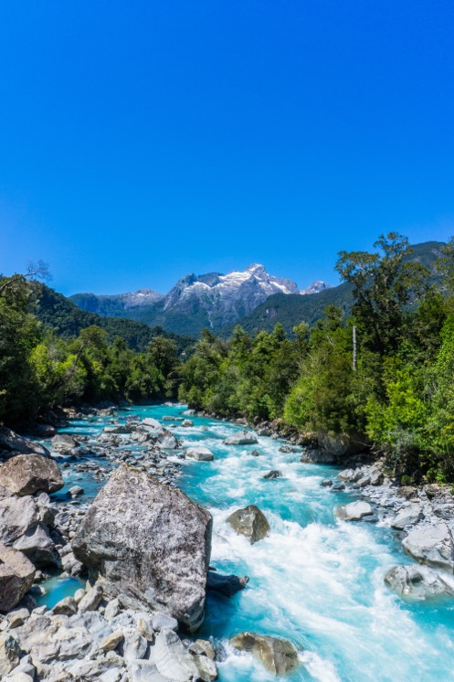
ClearWater-Riverine
Clearwater-Riverine simulates temperature and advanced nutrient cycling in branching river systems and floodplains, incorporating hydrodynamic, water quality, and meteorologic inputs from multiple data sources and models.
Flows: The model grid, volumetric flow, velocities, depths, diffusivity, etc. are provided by existing 2D hydro models.
HEC-RAS (2D)
GSSHA (in progress)
Modules: Water quality kinetics and heat budget simulation capabilities in ClearWater-Riverine are furnished by ERDC's ClearWater modules (e.g., NSM).
Transport: The ClearWater transport engine computes advection-diffusion of heat and mass through the model network.
Framework: The ClearWater framework links all the components together and performs the water quality compute sequence.
Currently design is based on decoupled modeling, i.e., the flows are pre-computed by the hydro models.

Slide 16
ClearWater-Riverine Example: E. Coli Transport in the Ohio River

Slide 17
ClearWater-Riverine Example: Comparison of ClearWater-Riverine with the EFDC Model

Slide 18
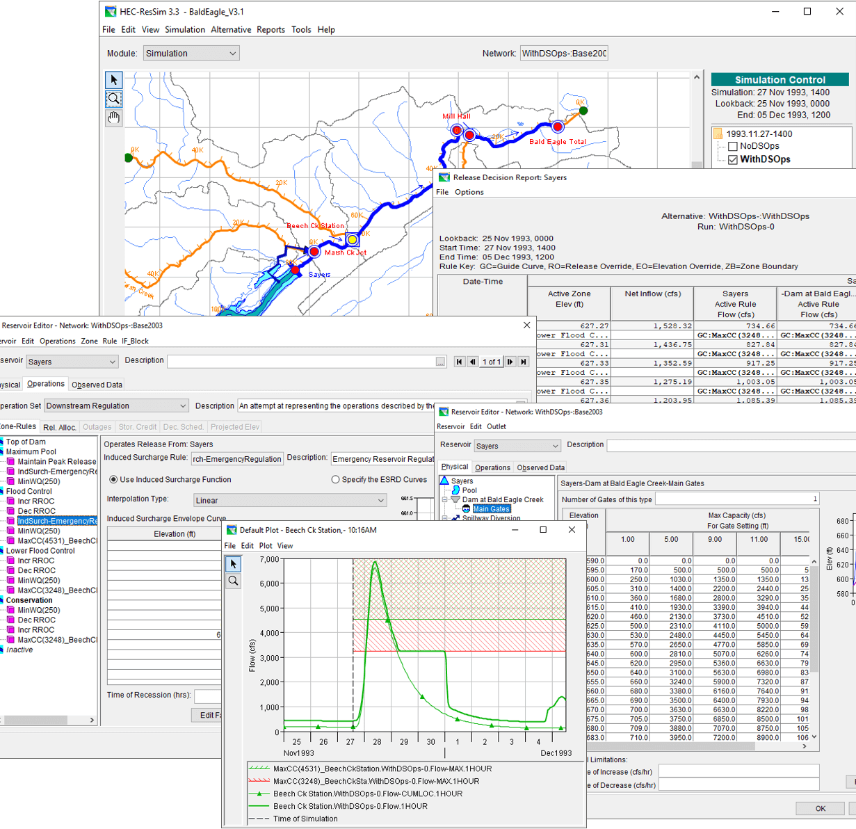
HEC-ResSim Water Quality
Develop fully integrated water quality capabilities into HEC-ResSim (Reservoir System Simulation)
HEC-ResSim simulates reservoir operations at one or more reservoirs for:
Flood management
Low flow augmentation
Water supply
Applications:
Planning studies
Detailed reservoir regulation plan investigations
Real-time decision support

Slide 19
Integrating Water Quality in Reservoir Release Decision-Making
Old Approach:
WQ was simulated after computing the hydrology and release decisions.
WQ operation rules were specified indirectly (using stage and flow) to meet environmental objectives.
Environmental objectives were often combined with other objectives, like navigation, flood control, or hydropower.
If the desired environmental benefits of an alternative are not achieved, new guesses need to be made, and the simulation recomputed. This stage has often been neglected.
Old Approach
New Approach
New Approach:
WQ is simulated in parallel with the hydrology and release decisions.
WQ operation rules can be specified directly (temperature, concentration, or load) to meet environmental objectives.
Environmental objectives can be specified and managed independently of other objectives, clarifying the environmental impacts of operation decisions.

Slide 20
Integrating Water Quality in Reservoir Release Decision-Making
HEC-ResSim-WQ Integration:
The Flow Engine computes the system flows based on input data and routing parameters.
The Water Engine computes:
1-D vertical hydrodynamics and water quality in the reservoirs
1-D longitudinal flows in the rivers
The Decision Engine evaluates all the specified rules based on the system flows and water quality.
ResSim then computes the releases.
During the simulation, flow and water quality information is saved for post-processing, visualization, and analysis.

Slide 21
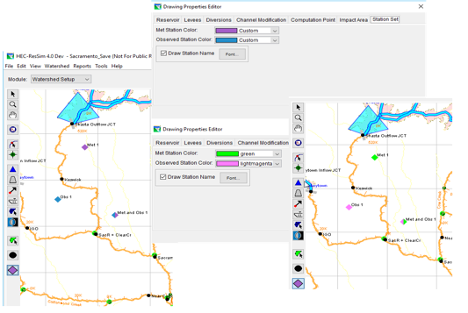
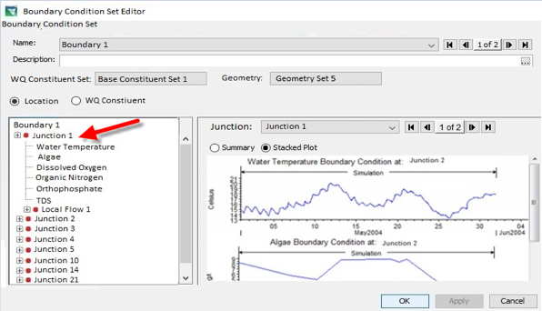
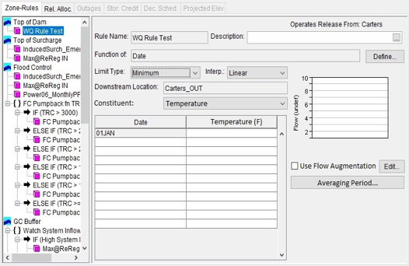
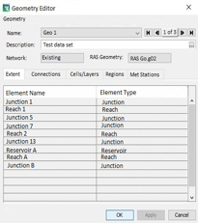
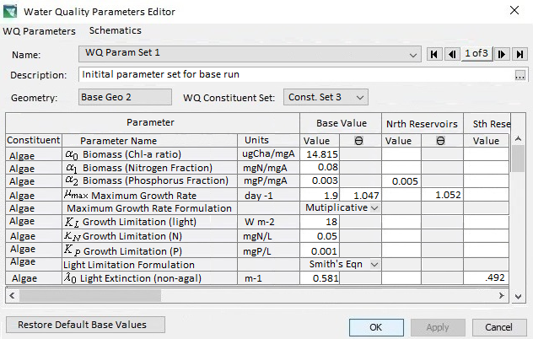
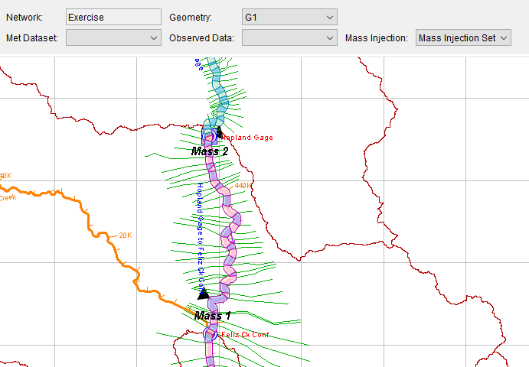
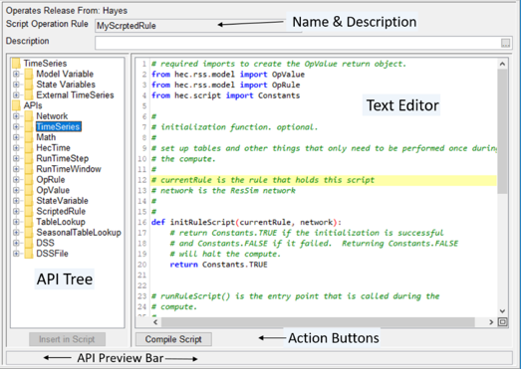
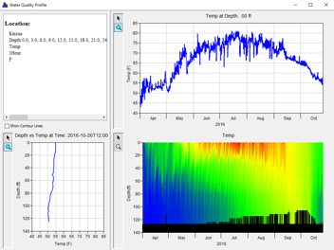
HEC-ResSim Water Quality Modeling User Interface
Model Geometry
Specifying Boundary Conditions
Operating Rule Priorities
Constituent Relation Parameters
Visualization
Scripted Rules and State Variables

Slide 22
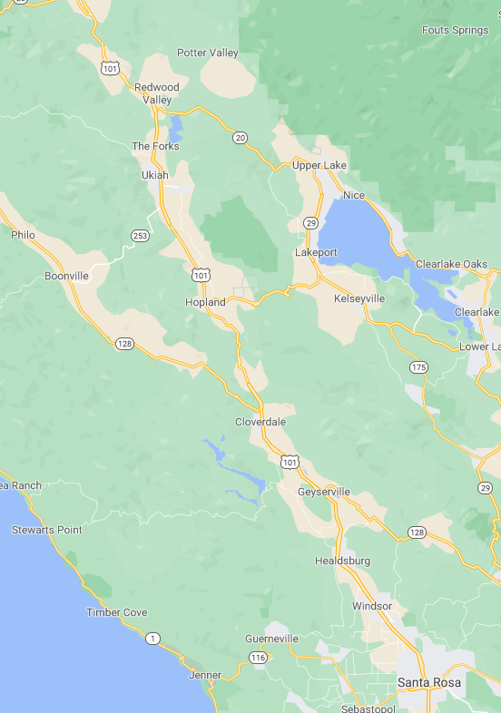
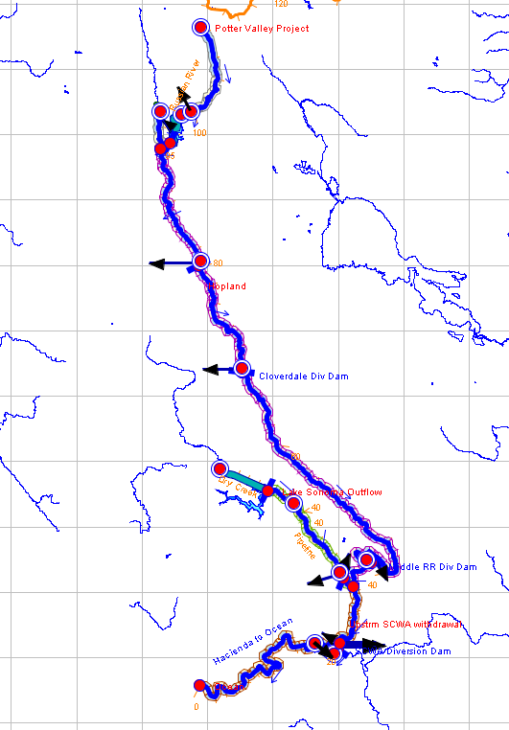
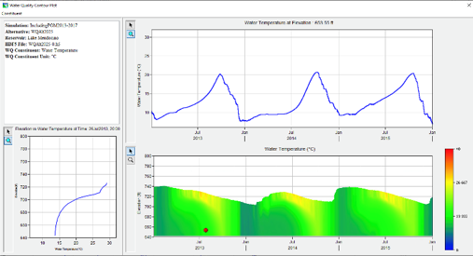

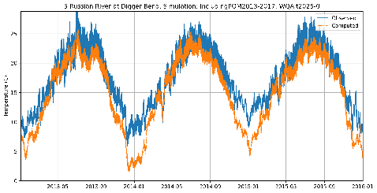
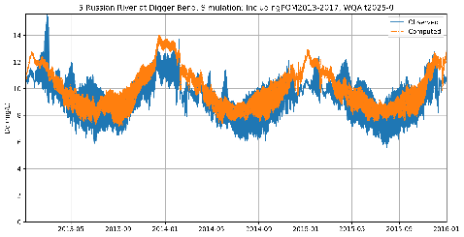
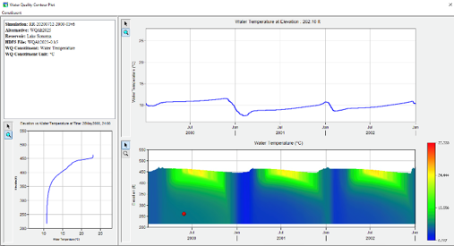
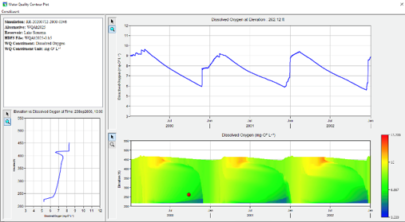
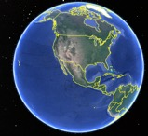
Temperature and Dissolved Oxygen Simulation with HEC-ResSim Russian River, California Prepared by RMA for the Sonoma County Water Agency
Temperature
Dissolved Oxygen
Lake Mendocino
Temperature
Dissolved Oxygen
Lake Sonoma

Slide 23
LTFATE
DOER’s Long-term Fate model
Fully integrated 3D Hydrodynamic, Salinity, Temperature, Sediment Transport, Contaminant Transport and Water Quality Modeling System.
Simulates the current- and wave-driven transport of multiple classes of cohesive and noncohesive sediments.
Simulates the transport and fate of multiple organic and metal contaminants.
The kinetic processes included in the LTFATE water quality model are derived from the CE-QUAL-ICM water quality model (Cerco and Cole, 1995) as described in Park et al. (1995).

Slide 24
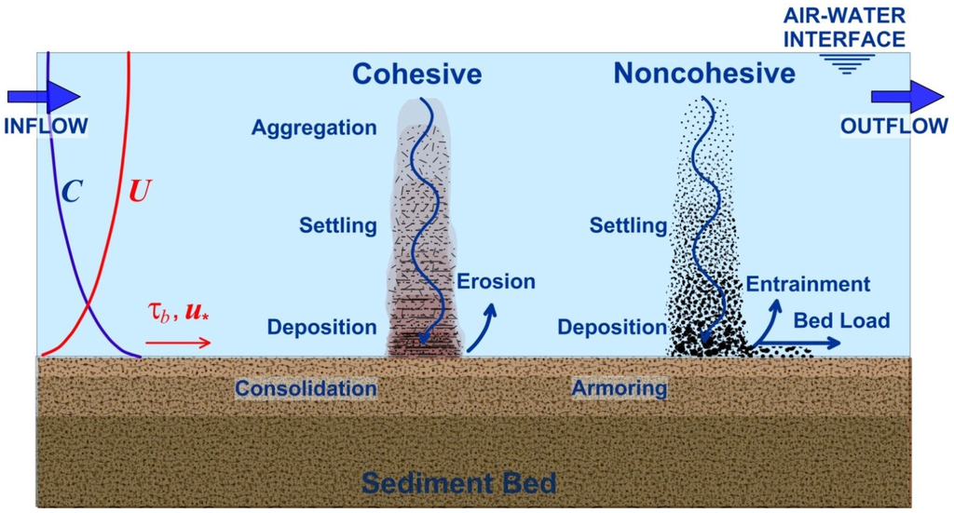
Sediment Transport
Waves Current
Mixed Sediments
Shrestha et al. (2014)
Notes:
https://visualstudio.microsoft.com/downloads/
https://www.intel.com/content/www/us/en/developer/tools/oneapi/toolkits.html#gs.1cmczg

Slide 25
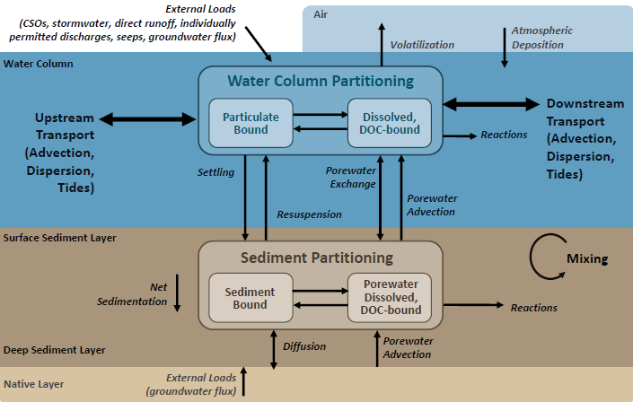
Contaminant Transport Model

Slide 26
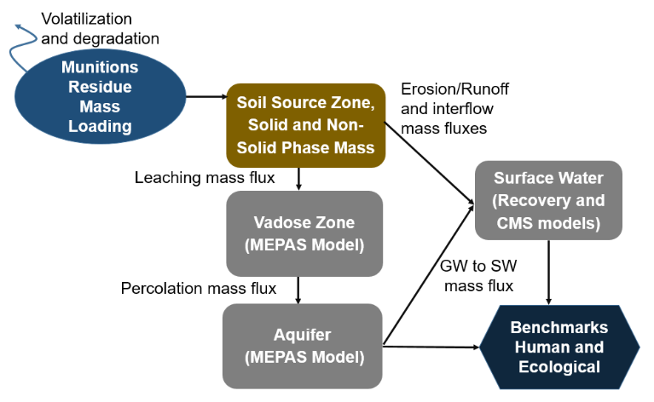
Groundwater Quality
Off-the-shelf hydro and BioGeoChem models used for applications
MODFLOW
FemWater
HydroGeoSphere
PHREEQC+
MINEQL+
Model choice largely driven by customer history and the BioGeoChem processes needed for the case
Interest in improved GW/SW BioGeoChem processes
Interest in developing PFAS workflow, MEPAS replacement
FRESCO
System of 1D, lumped parameter models
Applied for screening worst case scenarios aligned to ORAP
Current continued development of constituent databases and exploration of application for PFAS

Slide 27

Discussion

